Slide 1
BOOK BANK SYSTEM
BY
R.AKSHAYA
S.ASHIKA

Slide 2
INTRODUCTION
Under any particular book shop, there are various number and types of books available and it is sometimes even difficult for the book shop owner to remember the details of any particular book. With this new book shop system, shopkeeper will find easier to perform all the operations which are needed for their daily business transactions. If the customer wants to purchase any book, then they have to just enter the correct option and enter the name of the book which they want. If the book is available in the shop, it will generate the final bill which is to be paid by the customers at the cash counter and receive that particular book. If no such book is available, then appropriate message will be displayed for the users and expected date by which this book will be available in the shop. Admin will have the responsibility to add, delete and modify records related to book such as book name, quantity available, price per book etc.

Slide 3
Concept used in the system
This system is created using C++ and the concept of binary search method to make searching process faster and provide results within short interval of time. As each module is divided into classes and functions, the execution time of this system is optimized. To make data secure and maintain data integrity proper mechanism has been used to perform validation process at the client side before saving any data and information to a particular file. Users will be provided with friendly screen to do various operations.

Slide 4
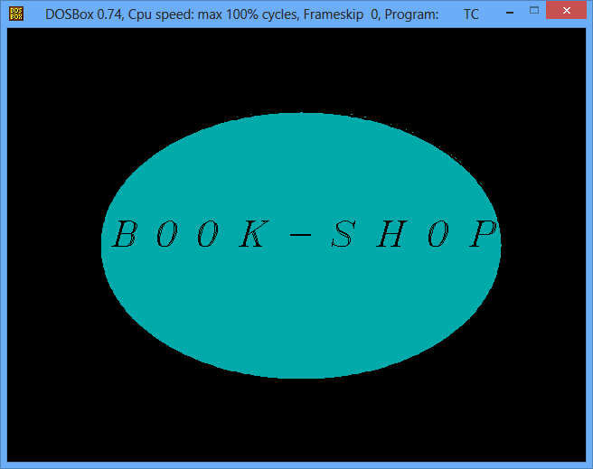

Slide 5
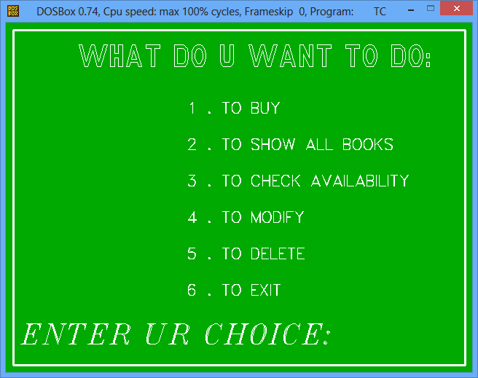

Slide 6
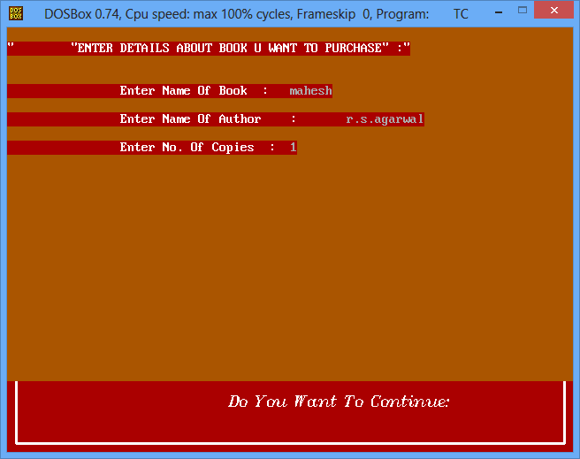

Slide 7
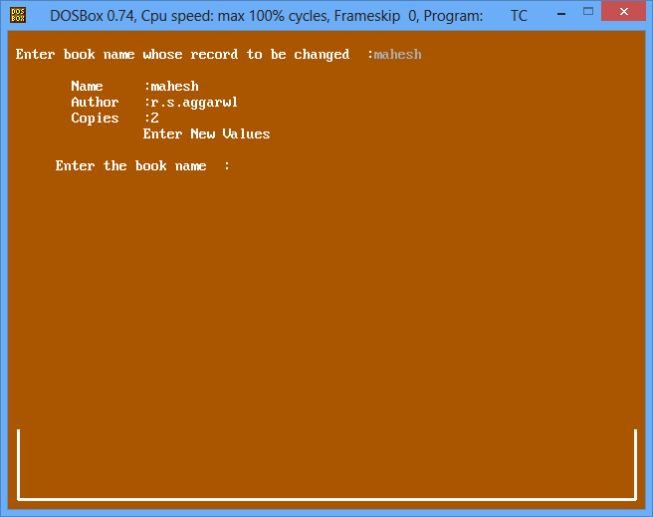

Slide 8
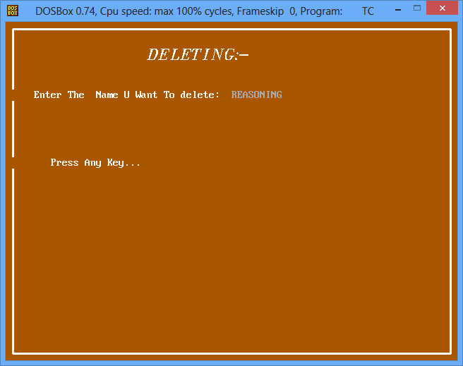

Slide 9
Conclusion
This system is useful to search the book whether it is available in the shop or not and it also find how many books are available.
Instead of searching the entire shop using this system we can easily find whether the books are available or not.

